Slide 1

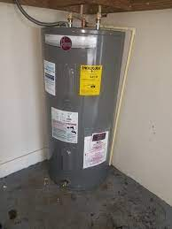
Amit Learning: Electric water heater
Made by: David wael wahib, Mohamed medhat mohamed, Ayatullah medhat mohamed.

Slide 2
Items needed for the project:
Lm35
7 segment
Fan cooler
Heater
Push buttons
Relay
AVR microcontroller (ATmega32)

Slide 3
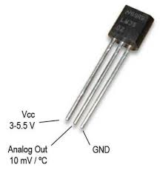
LM35 (input)
A sensor that senses the temperature and display it. The problem is that this sensor is an analog sensor. Thus, it needs ADC to be readable.

Slide 4
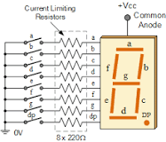
7 Segment (output)
This component consists of 7 LEDs(that is why it’s called 7 segments) arranged in a rectangular fashion as shown. An encoder is presented inside it to control every letter dependent on the input number.

Slide 5
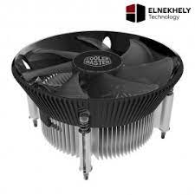
Fan cooler (output)
A motor that is used to cool objects by turning on the fan.

Slide 6
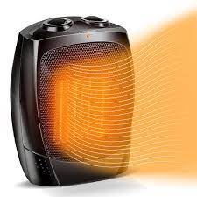
Heater (output)

Slide 7
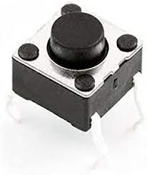
Push button (input)
A digital input switch that writes only 1 or 0 (0v-5v).

Slide 8
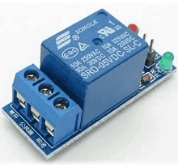
Relay (output)
Relays are electrically operated switches that open and close the circuits by receiving electrical signals from outside sources.

Slide 9
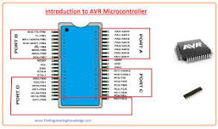
AVR microcontroller (ATmega32)
AVR microcontroller is an electronic chip manufactured by Atmel, which has several advantages over other types of microcontroller.

Slide 10
Project functionality:
It reads from the temperature sensor (lm35) by the analog-to-digital converter(ADC) to display it on the 7 segments. Then, the user starts to choose the temperature he needs, if it is higher than the sensor’s temperature, the fan cooler starts to decrease the temperature, but if it is lower, the heater starts to raise the temperature. This operation is done by pressing the needed push button which is coded by an external interrupt and connected to a relay that controls each component to stay on or off.

Slide 11
MCAL files needed
Dio.h
Dio.c
Registeraddresses.h
Interrupt_enable.h
Interrupt_enable.c
I2C.H
I2C.C

Slide 12
HALL files needed
Lm35.h
Lm35.c
Seven_segment.h
Seven_segment.c
Cooling_system.h
Cooling_system.c
Buttons.h
Buttons.c
EEPROM.H
EEPROM.C
PROTOCOLS.H
PROTOCOLS.C

Slide 13
APP files
main.c

Slide 14

Struggles faced:
Reading temperature more than 50 degrees.
Displaying average without adding the sum on it.
Testing the average.
Finding the EEPROM on proteus.

Slide 15


